Slide 1





Rihla
Project
Transportation Company
Branch
START SLIDE
Qena

Slide 2








Our Team Members
Mohamed Khaled
Ahmed Ashraf
Bi Developer
Bi Developer
Asmaa
Salah
Ahmed Hamdan
Bi Developer
Bi Developer

Slide 3




What is Rihla Project?
Database Creation
Designing and building a structured database to store ride, driver, customer, and payment data efficiently, ensuring accuracy, scalability, and easy access for analysis.
This project focuses on analyzing Rihla Car Services, a ride-hailing business model similar to Uber, using end-to-end data analytics techniques It covers database design, data warehousing, ETL pipelines, and advanced data visualization to extract meaningful insights and improve operational and financial performance.
Initializing Dashboards
Developing interactive dashboards to visualize key metrics such as revenue, trip volume, driver performance, and customer trends for data-driven decision-making.
Maintain The Website
Building a responsive and user-friendly website to present insights, dashboards, and project information, making data easily accessible to stakeholders.

Slide 4





Real-World Applications in our system
Trips
"Core ride-hailing service allowing passengers to book instant or scheduled trips with real-time tracking, dynamic pricing, and secure payments."
Freight
"On-demand freight transportation for goods and packages, enabling businesses and individuals to ship items efficiently with tracking and delivery confirmation."
Rent
"Car rental service offering short-term and long-term vehicle rentals directly through the app, with flexible pickup locations and seamless booking."

Slide 5
Rihla Workflow
The data analysis process in Rihla is designed to handle large-scale ride-hailing data efficiently. We start by understanding business needs, create a robust database, build a data warehouse, perform ETL operations, and finally deliver powerful insights through advanced visualization tools and a custom web dashboard.
01
Requirements Letter
03
DWH
05
Analyze &Visualize results
Collecting detailed business requirements from the client.
Building the data structure and populating it with relevant data.
Analyzing the data and visualizing the results using tools such as Power BI, Tableau, Looker, and Python.
02
Database Creation
ETL
Website
04
06
Designing and structuring the database using SQL queries.
Performing data extraction, transformation, and loading using SSIS, SSAS, and SSRS tools.
Developing the website with features including user login, registration, and a custom dashboard.

Slide 6
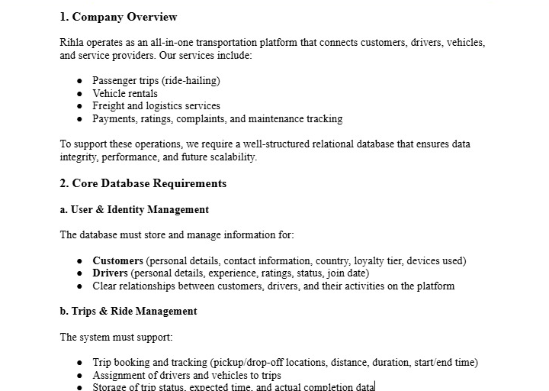
Requirements Letter
1/4
Rihla is an all-in-one transportation platform offering ride-hailing, freight logistics, and vehicle rentals with integrated payments and tracking. This requires a scalable relational database to manage users, trips, vehicles, transactions, and analytics efficiently.

Slide 7
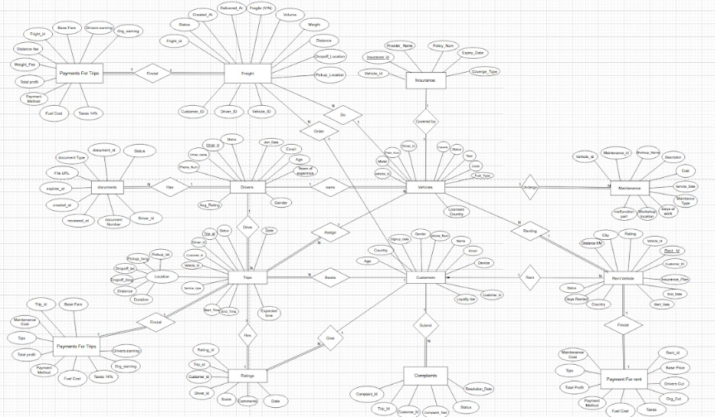
ERD
14 Entities

Slide 8
Database Content
Drivers
Rating
Licenses
Vehicles
Complaints
Maintenance
Insurance
Trips
Payment for trips
Rent
Payment for Rent
Freight
Payment for Freight

Slide 9
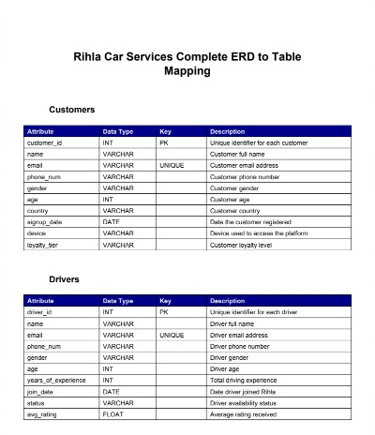
1/6
Mapping

Slide 10
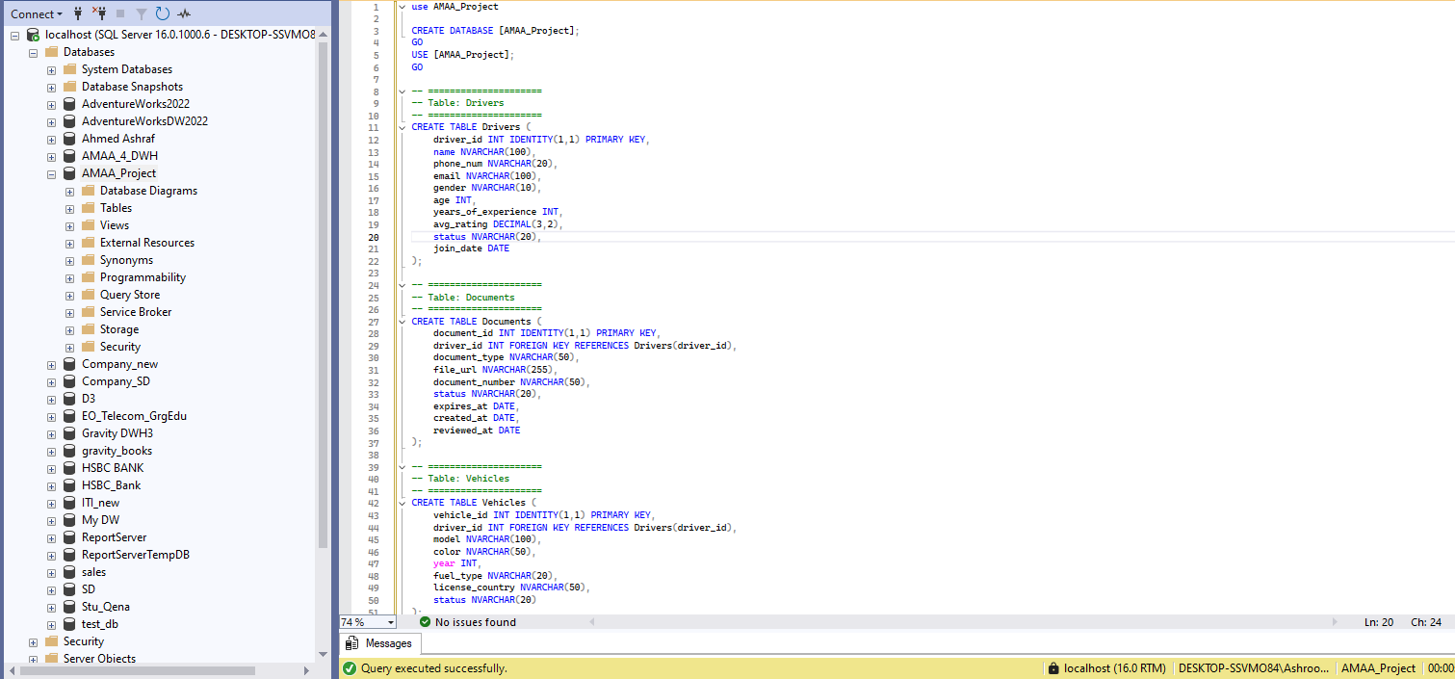
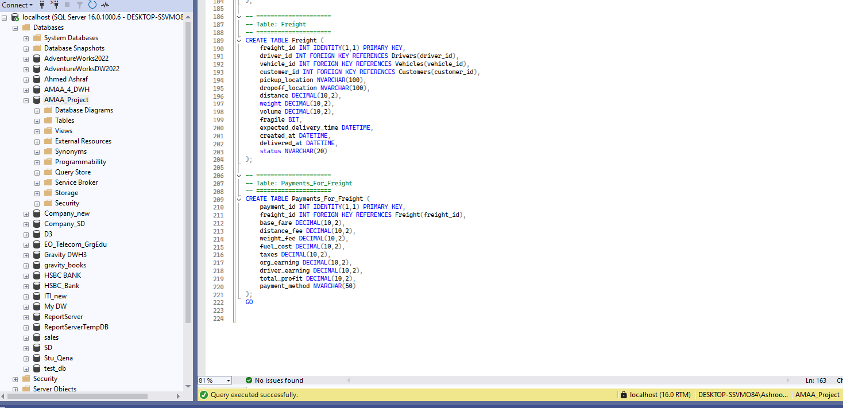
Database Creation
We design and build a structured relational database based on business requirements. Tables are carefully defined with appropriate data types, primary keys, and foreign keys to ensure data accuracy and consistency. Relationships between entities such as Drivers, Trips, Freight, and Payments are established to maintain referential integrity, enabling efficient data storage, retrieval, and future analytics.

Slide 11
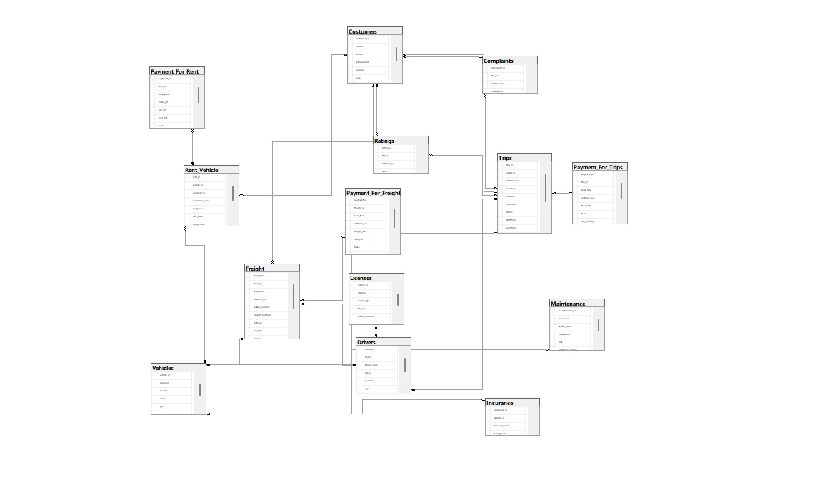
Database Diagram

Slide 12
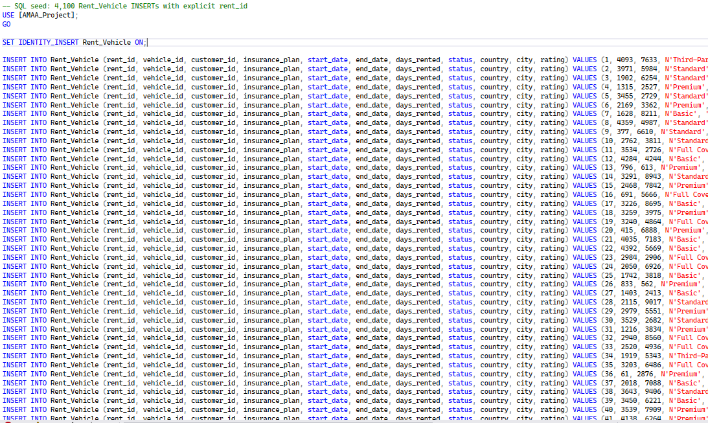
Data Insertion
To populate the Rihla database with realistic data, we executed multiple INSERT statements into the Rent_Vehicle table, covering vehicle details, rental periods, customer ratings, and insurance plans.

Slide 13
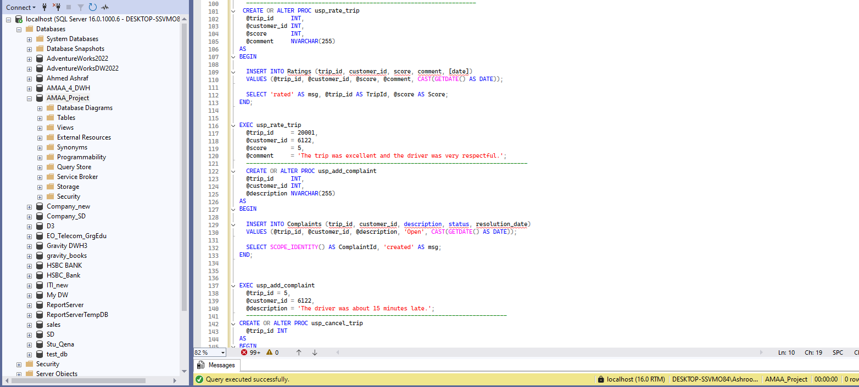
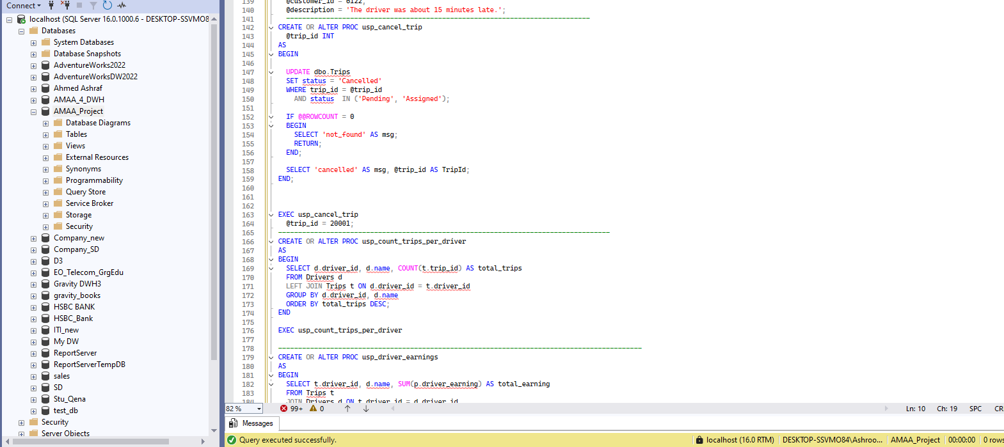
Proc
Add Complaints
Update Trips status

Slide 14
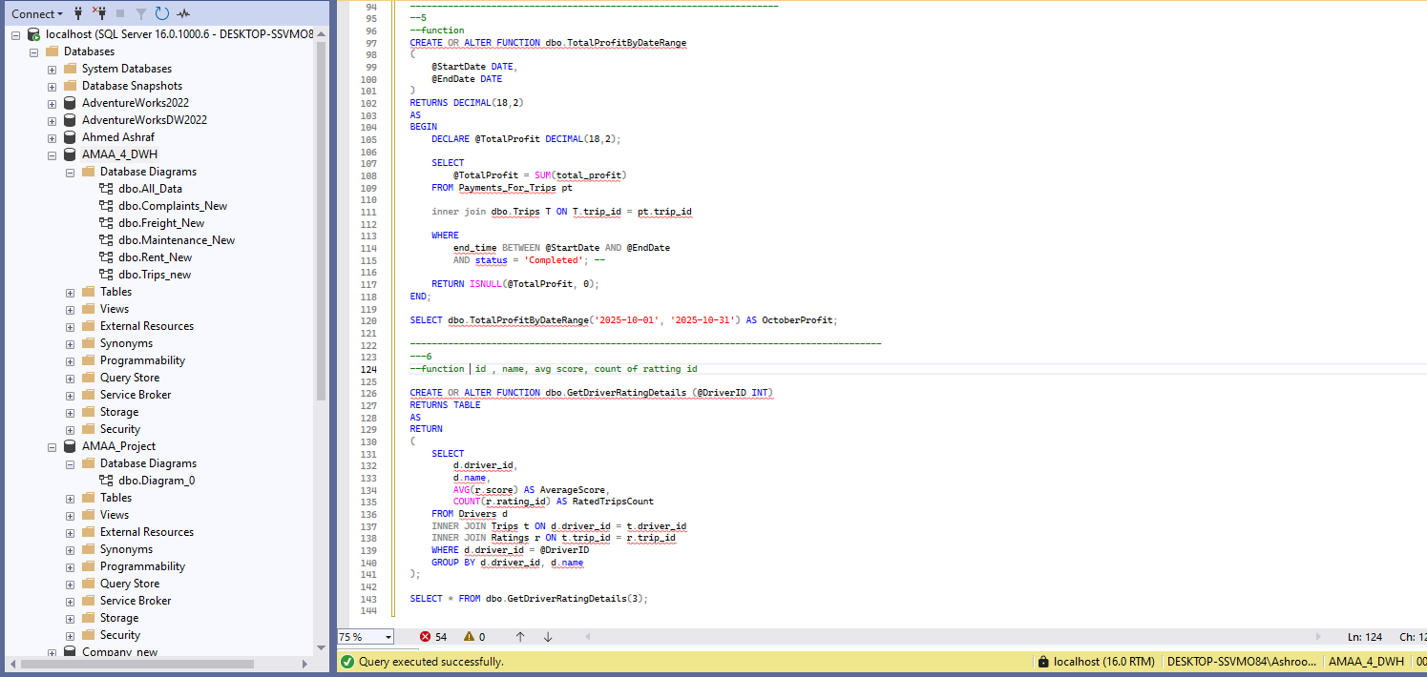
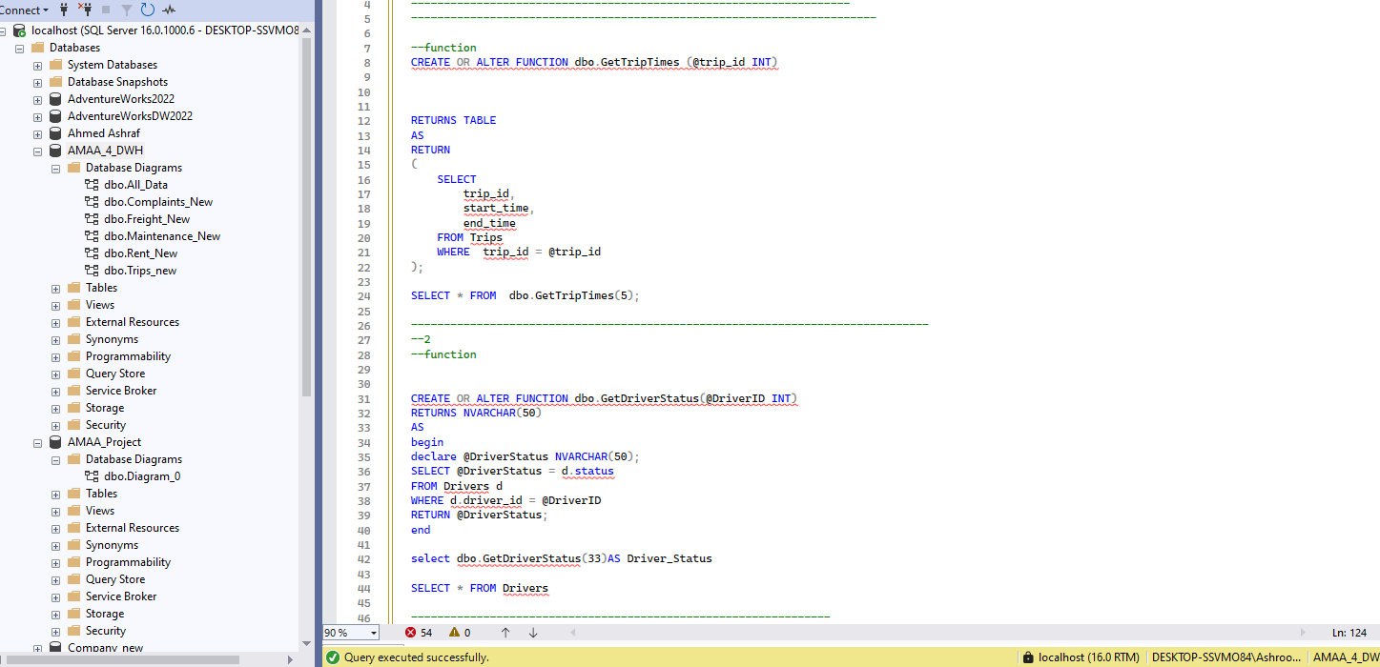
`
Getting Trip Duration
Function
Getting time trips
Retrieving Driver Ratings

Slide 15
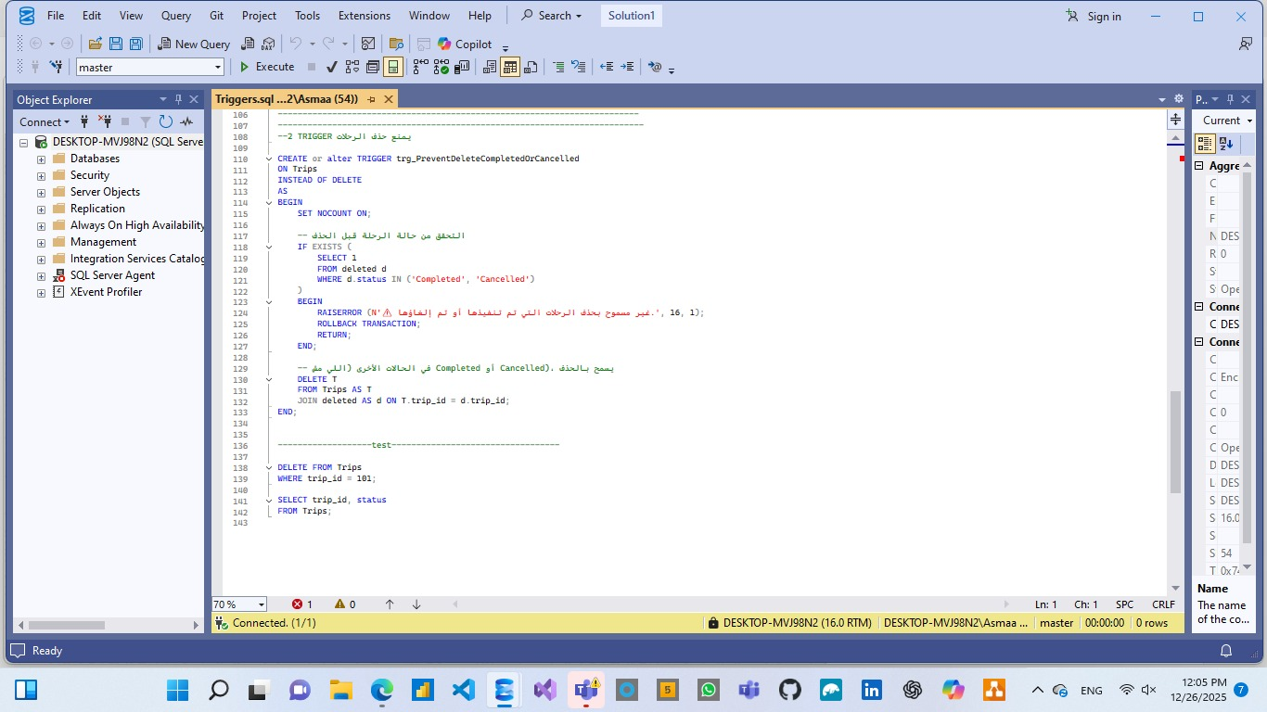
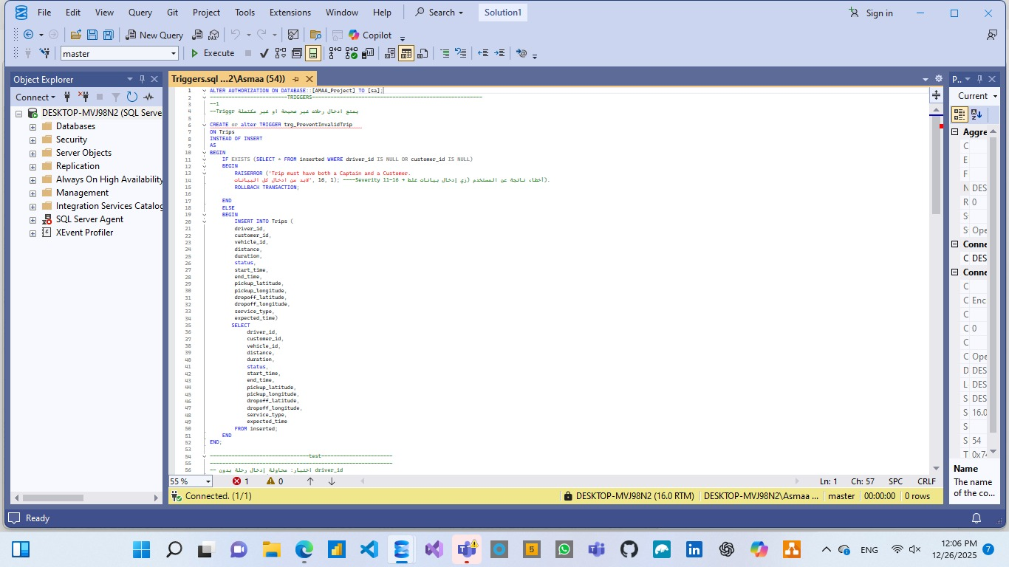
Trigger to Prevent Inserting Incomplete or Invalid Data
Triggers
Trigger to Prevent Trip Deletion

Slide 16

Leveraging Microsoft SQL Server to perform advanced data analysis on Rihla's platform.
Extracting actionable insights from trips, freight, and rental data to identify trends, optimize dynamic pricing, improve driver allocation, and enhance overall service efficiency.
Data Analysis

Slide 17
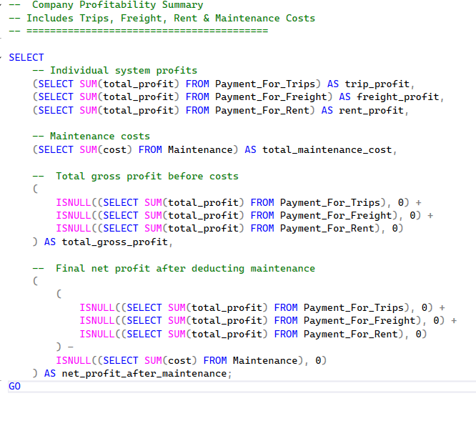
Data Analysis

Slide 18


DWH
Data Warehouse (DWH) is a centralized repository designed for storing, managing, and analyzing large volumes of historical data from multiple sources to support business intelligence and reporting.
In Rihla, the DWH integrates data from ride-hailing trips, freight logistics, and vehicle rentals, enabling efficient querying, trend analysis, and data-driven decisions to optimize operations and pricing strategies.

Slide 19
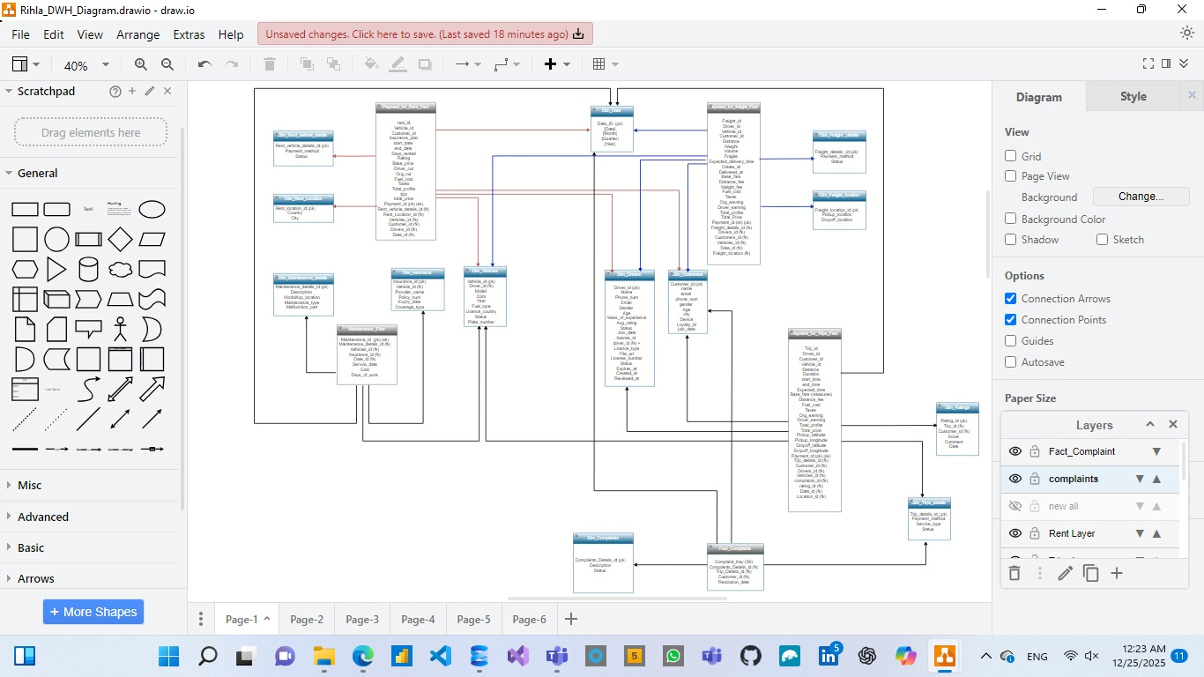
Galaxy Schema
5 Fact tables

Slide 20
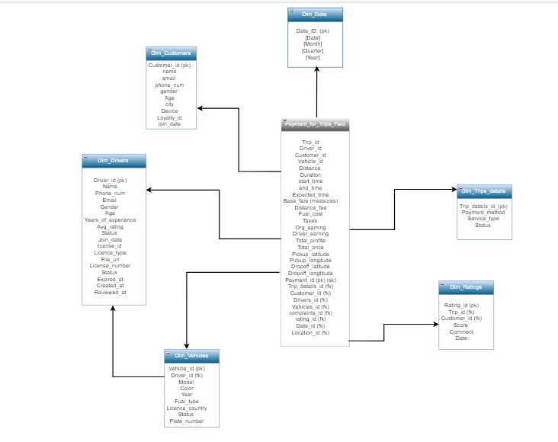
Trips Diagram

Slide 21
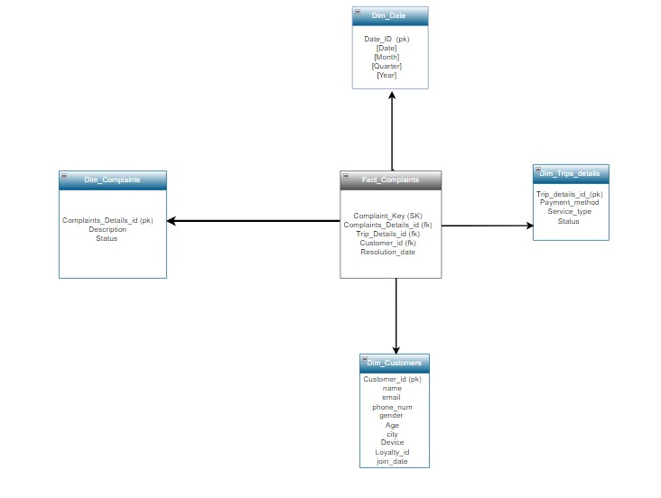
Complaints Diagram

Slide 22
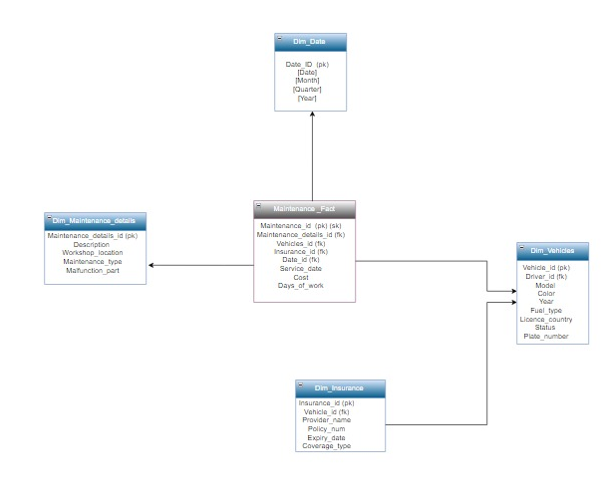
Maintenance Diagram

Slide 23
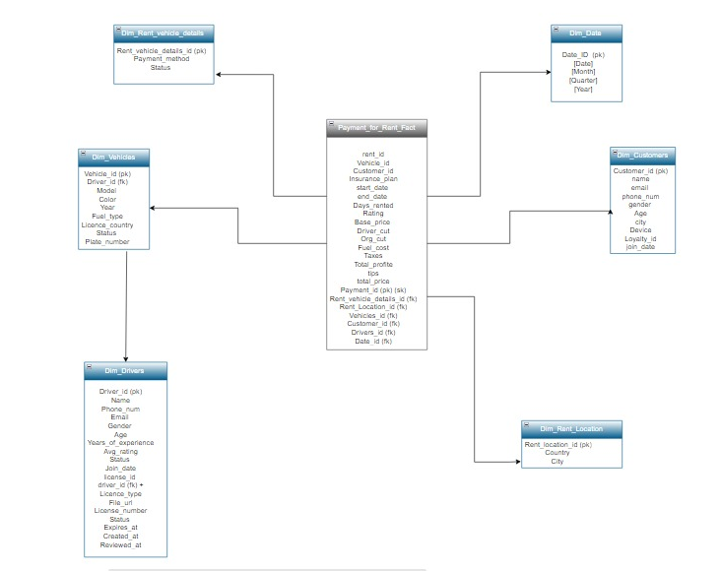
Rent Vehicle Diagram

Slide 24
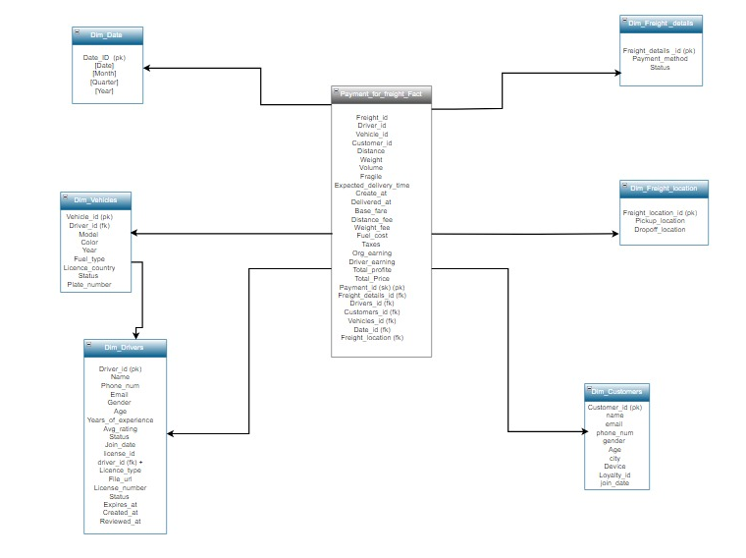
Freight Diagram

Slide 25

ETL (SSIS)
We use SSIS to extract data from SQL sources, transform it according to business rules, and load it into the Data Warehouse. The process also supports data integration between SQL systems and exporting data to Excel files for reporting and analysis.

Slide 26
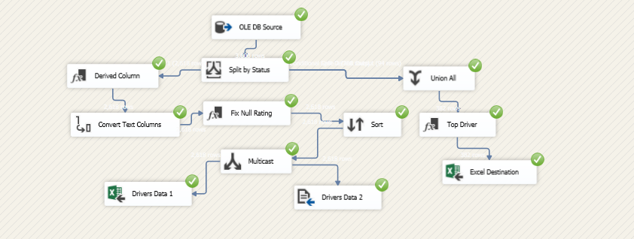
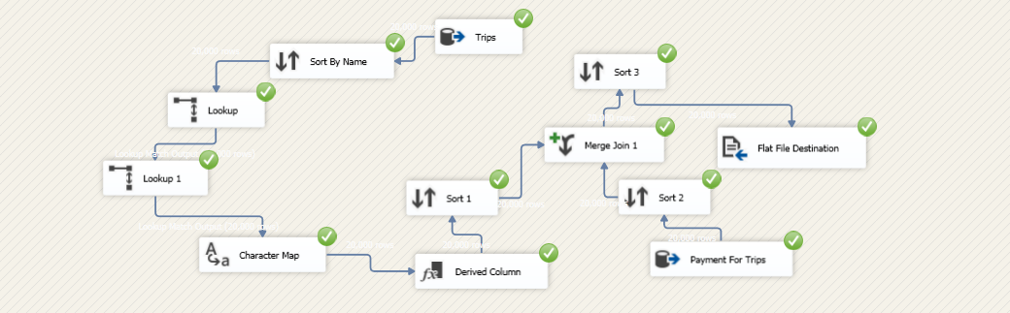
SSIS
Extract the data from SQL server to Excel File Destination

Slide 27
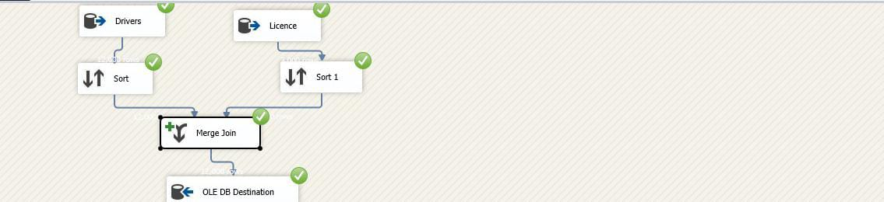
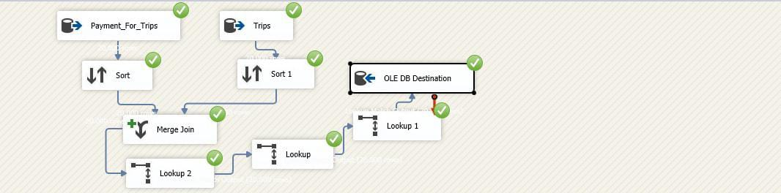
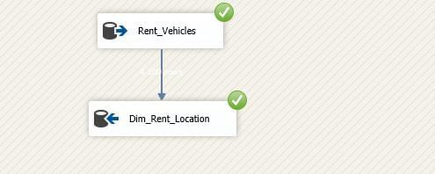
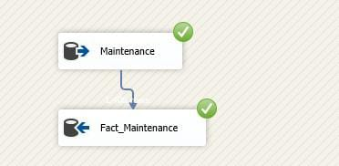

SSIS
Extract data from SQL data base to SQL DWH Destination

Slide 28
SSAS
We make analysis by SSAS
Utilizing SQL Server Analysis Services (SSAS) to build multidimensional cubes for advanced analytics. This enables in-depth reporting on vehicle rental profitability, driver earnings, tips distribution, and total revenue across Rihla's rent service

Slide 29
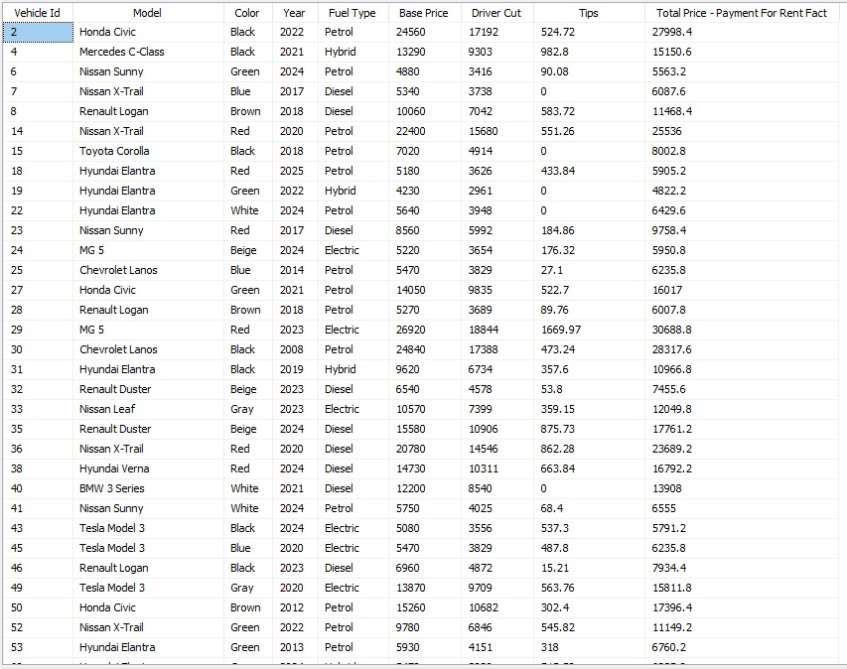
SSAS
SSAS multidimensional analysis reveals that electric vehicles like Tesla Model 3 generate the highest rental revenue (up to $17,761), driven by high demand despite moderate base prices. Luxury models (e.g., Mercedes C-Class) achieve strong profitability through premium pricing, while economy cars attract higher tips, contributing significantly to overall driver earnings and platform performance

Slide 30
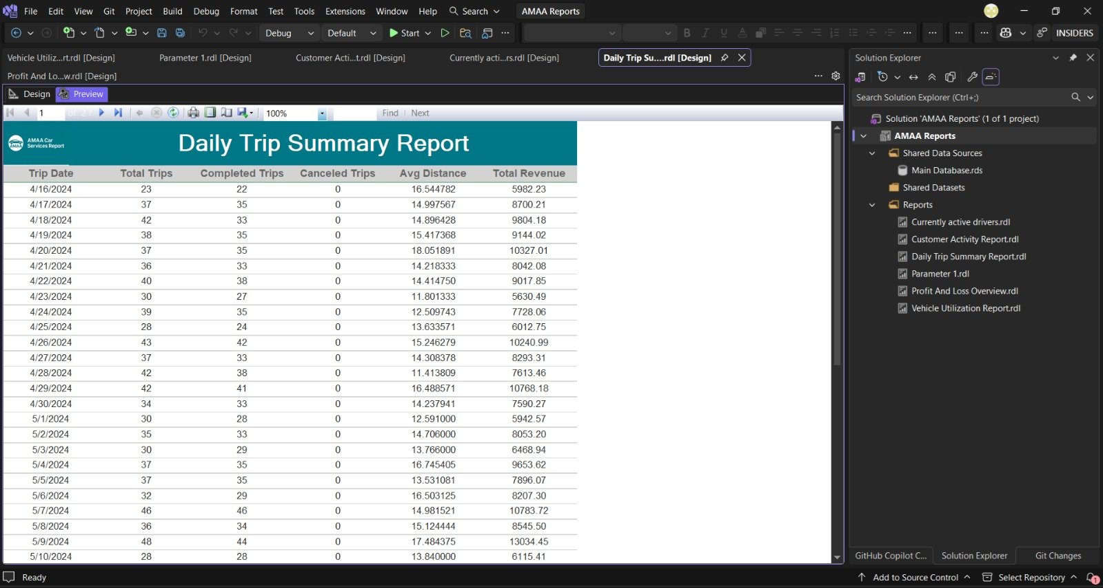
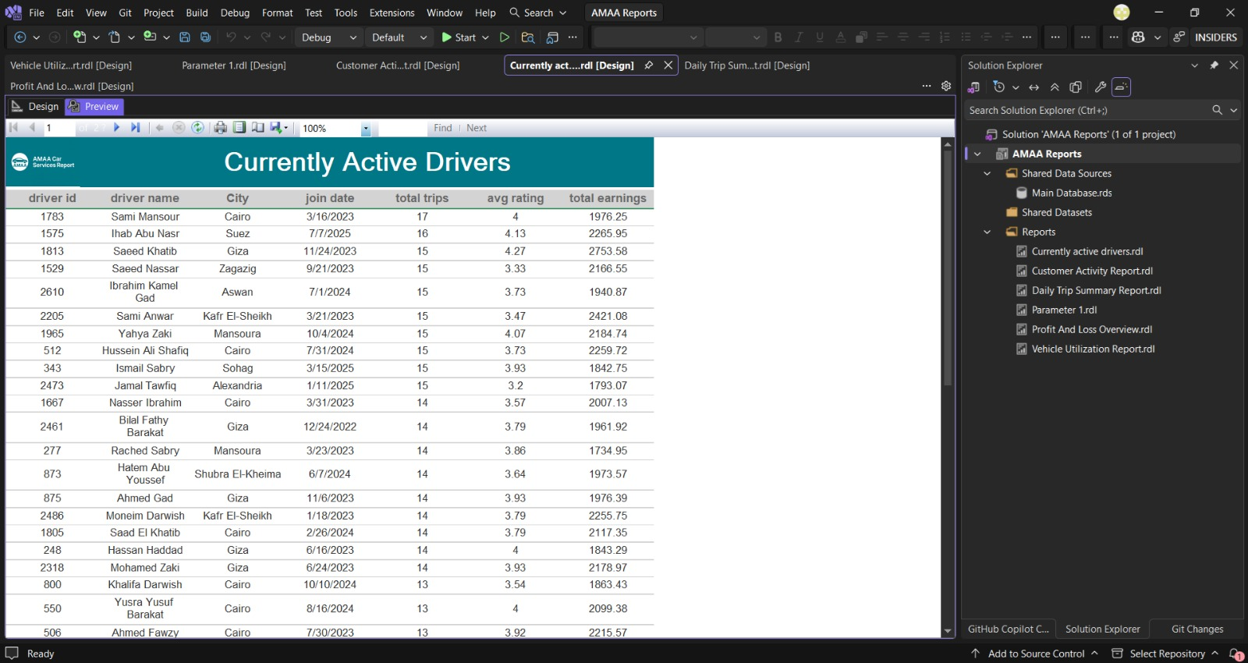
SSRS
Leveraging SQL Server Reporting Services (SSRS) to deliver interactive operational reports. Key reports include daily trip summaries with completion rates and revenue, alongside real-time monitoring of active drivers' performance, ratings, and earnings.
.

Slide 31
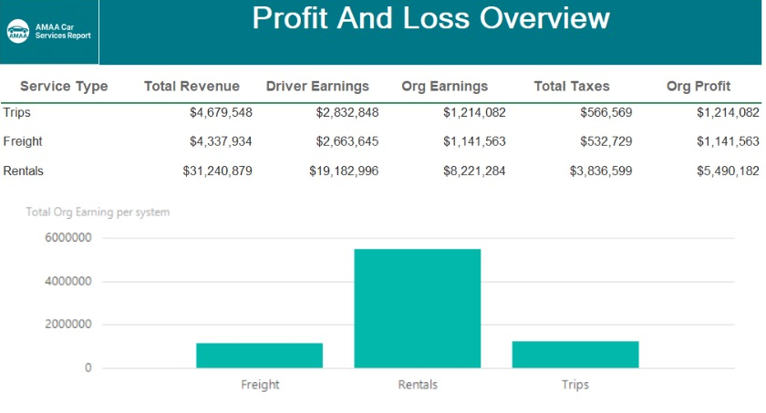
SSRS
SSRS Profit & Loss Overview highlights Rentals as the most profitable service, generating $5.49M in organizational profit – over 4x higher than Trips. Trips lead in total revenue ($4.68M) but yield lower net profit ($1.21M) due to higher driver payouts, while Freight remains the least profitable segment.

Slide 32



Visualization
Why we used these tools?
POWER BI
Tableau
Looker
Microsoft Power BI provides powerful, interactive dashboards with seamless integration to SQL Server, enabling real-time monitoring and advanced data modeling for Rihla's operational insights.
Tableau delivers highly interactive and visually compelling dashboards, enabling stakeholders to uncover hidden patterns and perform advanced exploratory analysis on Rihla's complex ride-hailing, freight, and rental datasets.
looker offers embedded analytics and a modern data platform, empowering self-service exploration and consistent metrics across Rihla's trips, freight, and rental services

Slide 33
Tableau
Tableau empowers Rihla with industry leading data visualization capabilities, delivering highly interactive and aesthetically superior dashboards. Its advanced features enable deep exploratory analysis, allowing stakeholders to uncover hidden insights across trips, freight, and rental operations with unparalleled clarity and speed

Slide 34
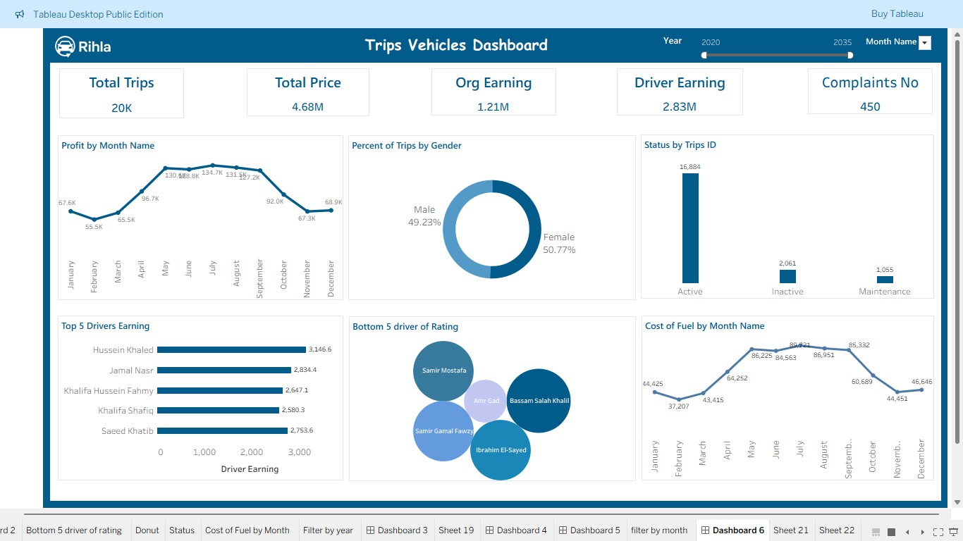
Data Visualization
Trips Dashboard
- The dashboard shows strong performance with 20K trips and 4.68M total revenue, indicating steady business growth.
- Trips are evenly distributed by gender, suggesting balanced customer usage across segments.
- Top drivers contribute significantly to earnings, so sharing their best practices could improve overall driver performance.
- 450 complaints highlight areas for service improvement, especially to enhance customer satisfaction.
- Fuel costs vary by month, so optimizing routes and monitoring fuel usage can help reduce operational expenses.

Slide 35
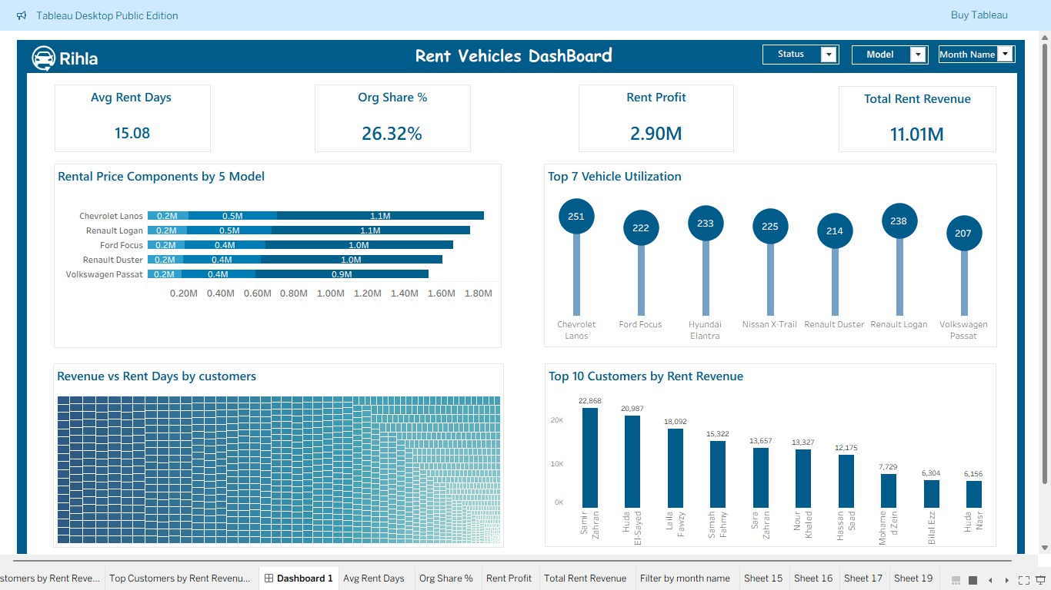
Data Visualization
Rent Dashboard
The dashboard shows 11.01M total rental revenue with 2.90M profit, indicating strong rental business performance.
Average rent duration is 15 days, suggesting customers prefer mid- to long-term rentals.
Vehicle utilization varies by model, with some models performing significantly better, highlighting opportunities to optimize the fleet mix.
Revenue increases with longer rental days, showing that long-term customers are more valuable.
Recommendation: Focus on high-utilization models, promote longer rental periods, and reconsider low-performing vehicles to maximize profitability.

Slide 36
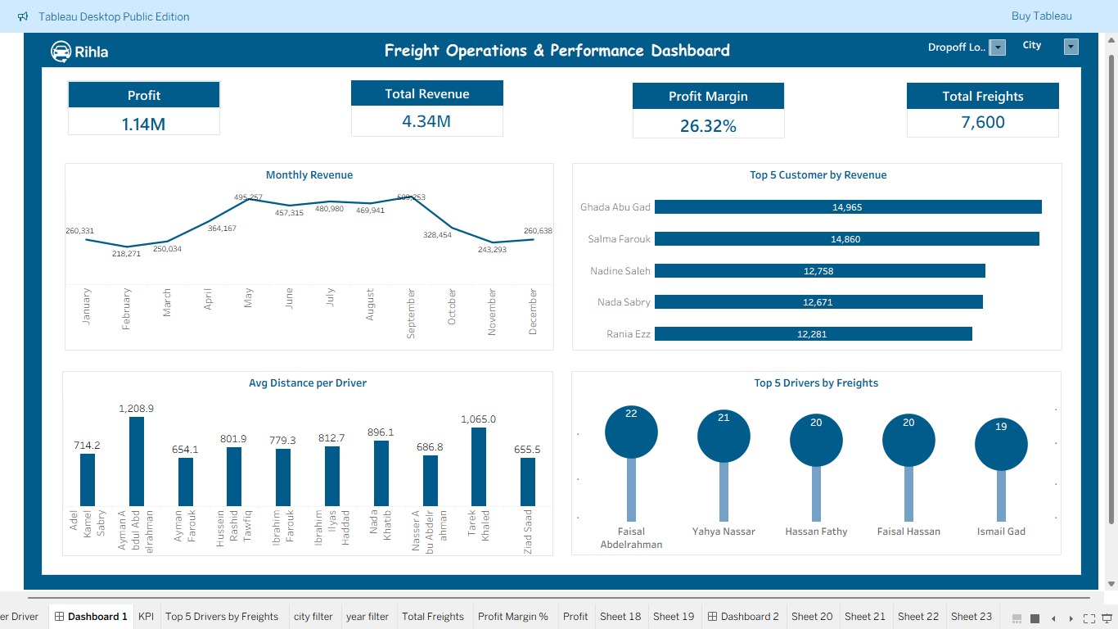
Data Visualization
Freight Dashboard
The dashboard shows strong financial performance with a profit of 1.14M and total revenue of 4.34M, along with a healthy profit margin of 26.32%. Monthly revenue peaks mid-year, while top customers and drivers play a key role in performance. To improve, focus on strengthening customer relationships, balancing driver workload, and optimizing costs to boost margins. Understanding seasonal trends could also help drive more sales in slower months.

Slide 37
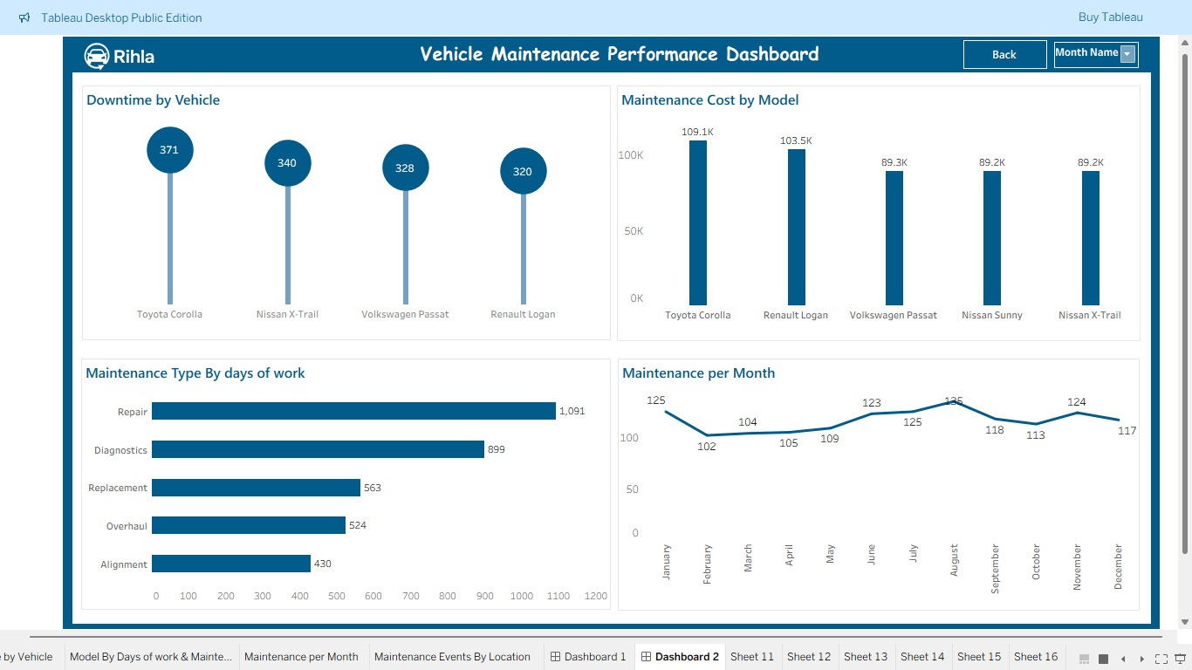
Data Visualization
Maintenance
Dashboard
The dashboard shows that Toyota Corolla has the highest downtime and maintenance cost, indicating frequent or costly issues. Repairs and diagnostics make up most maintenance work, suggesting a need for better preventive maintenance. Maintenance activity fluctuates through the year, with noticeable peaks in some months. Focusing on high-downtime vehicles and improving preventive checks could reduce costs and downtime.

Slide 38

Power BI
Power BI empowers Rihla with seamless integration to Microsoft SQL Server and robust data modeling capabilities, delivering dynamic and interactive dashboards. Its intuitive interface and advanced DAX calculations enable real-time performance monitoring, predictive insights, and comprehensive reporting across trips, freight, rentals, and maintenance operations.

Slide 39
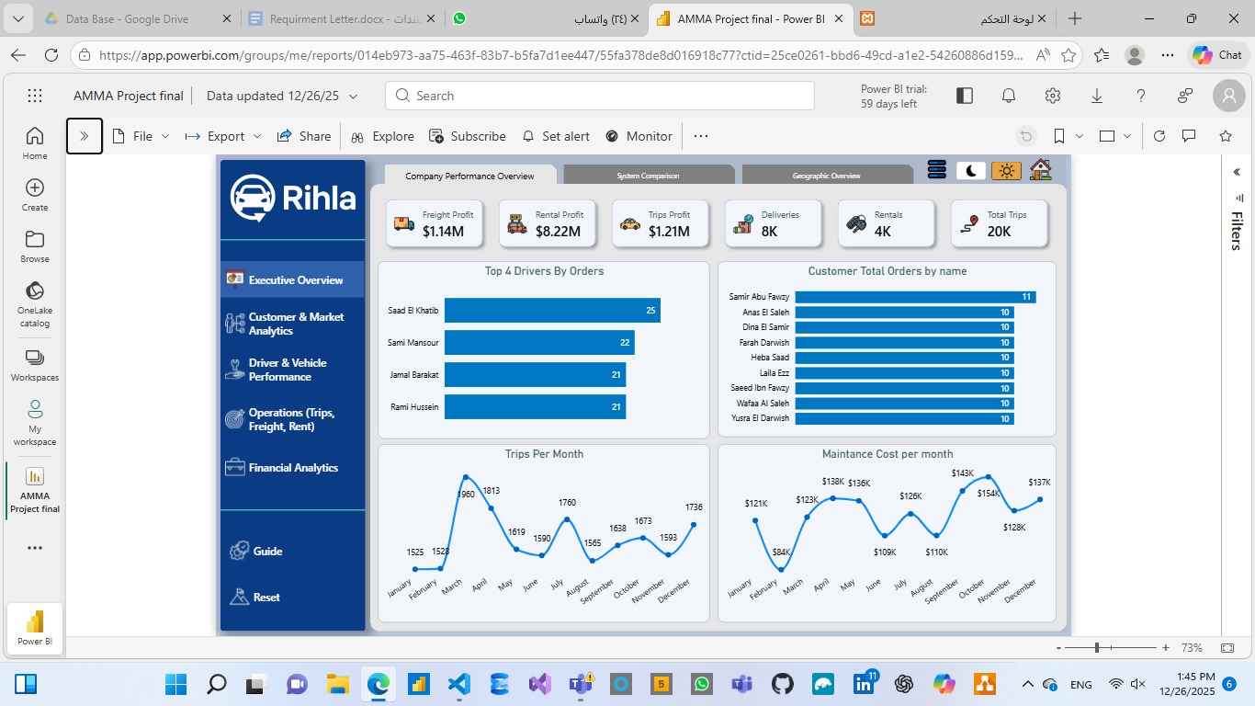
Data Visualization
Trips Dashboard
The Trips Dashboard in Power BI presents a high-level executive overview of Rihla's ride-hailing operations, generating $1.14M in freight profit, $8.22M in rental profit, $1.21M in trips profit, alongside 8K deliveries, 4K rentals, and 20K total trips. Key insights highlight top driver Saeed El Sherbiny leading with 31 orders, frequent customer Samir Abu Fathy placing 11 orders, monthly trip volumes peaking at 1,913, and maintenance costs stabilizing around $12K–$15K in recent months.

Slide 40
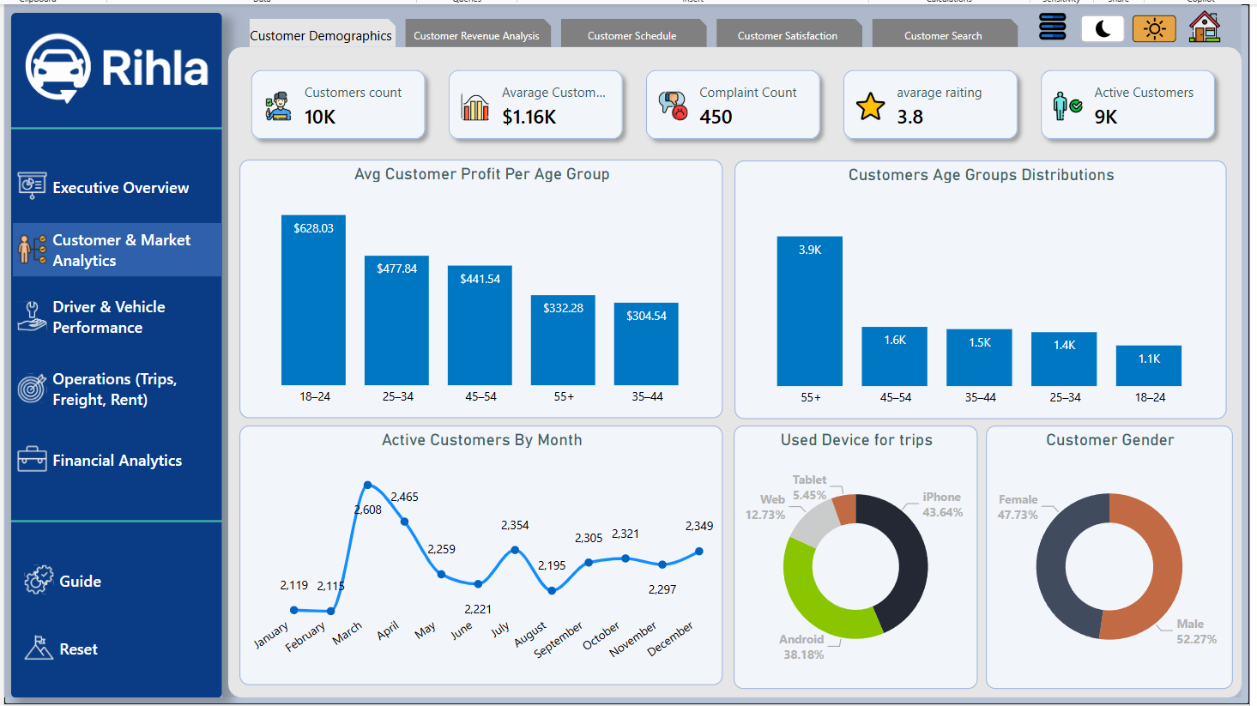
Data Visualization
Rent Dashboard
This dashboard shows a strong customer base with 10K customers and 9K active users, generating an average customer value of $1.16K. Younger customers (18–24) deliver the highest profit per customer, while older groups (55+) represent the largest segment by count. Customer activity fluctuates monthly, peaking around spring and mid-year. Most trips are made via mobile devices, especially iPhone and Android. To improve performance, focus on engaging high-profit younger users while boosting retention and satisfaction among older customers and addressing complaints.

Slide 41
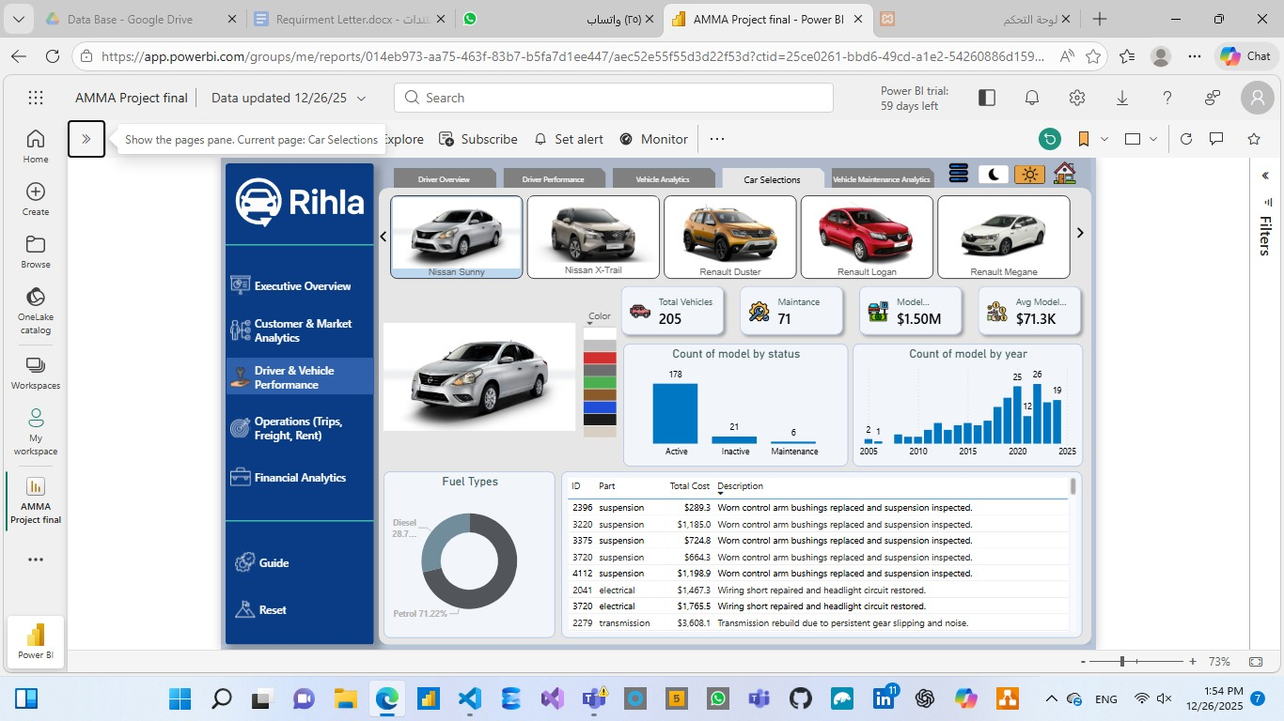
Data Visualization
Rent Dashboard
The Rent Dashboard provides a comprehensive fleet management overview for Rihla's rental service, tracking 205 total vehicles, 71 maintenance cases, an average model year of 2019, and total maintenance cost of $71.3K. Key insights include Nissan Sunny as the most common model, predominant petrol fuel type (71.2%), 179 active vehicles versus 21 in maintenance, and top maintenance descriptions led by suspension repairs ($1,183) and worn cornet arm bushings ($1,192).

Slide 42
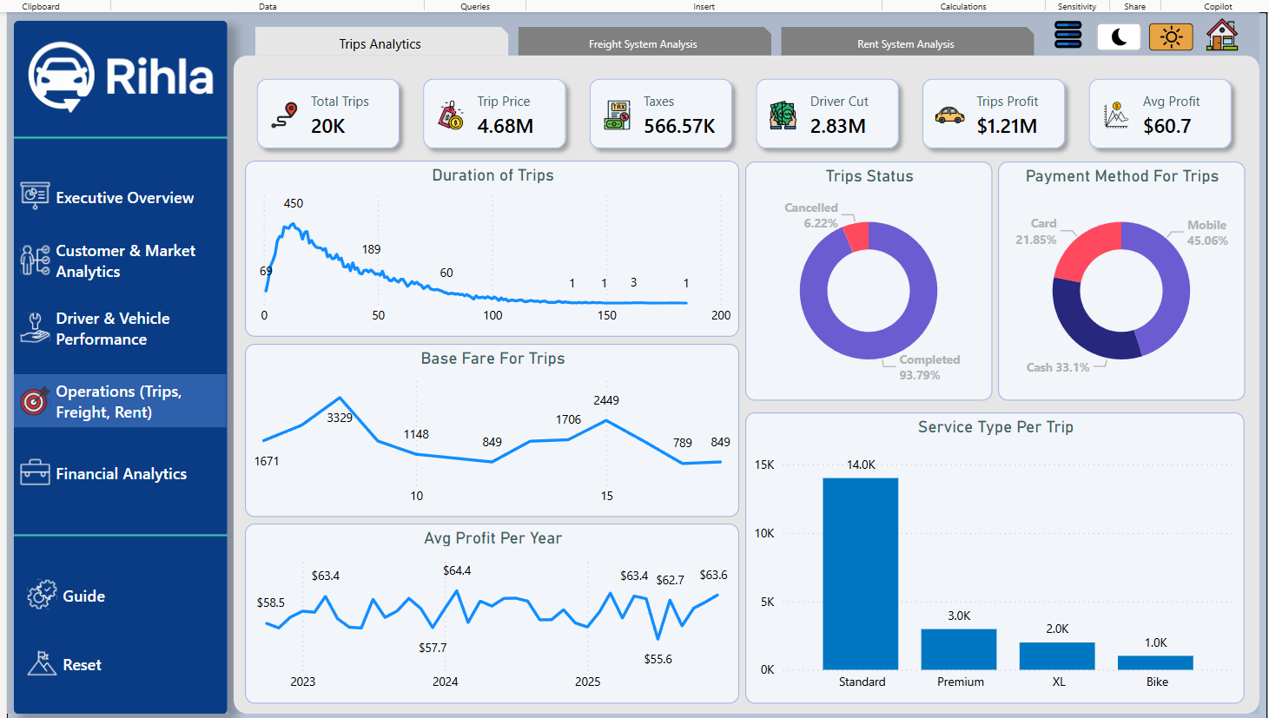
Data Visualization
Rent Dashboard
This dashboard presents an overview of trip analytics for a ride service. It shows key metrics such as 20K total trips, a profit of $1.21M, and average profit per trip of $60.7. The most common service type is Standard, with 14K trips. Payment methods are split with 45% mobile, 33% cash, and 21.85% card. A recommendation would be to focus on optimizing mobile payment options, as they dominate, and explore ways to reduce trip cancellations (currently at 6.22%). Additionally, investing in premium services could drive higher profits based on demand patterns.

Slide 43
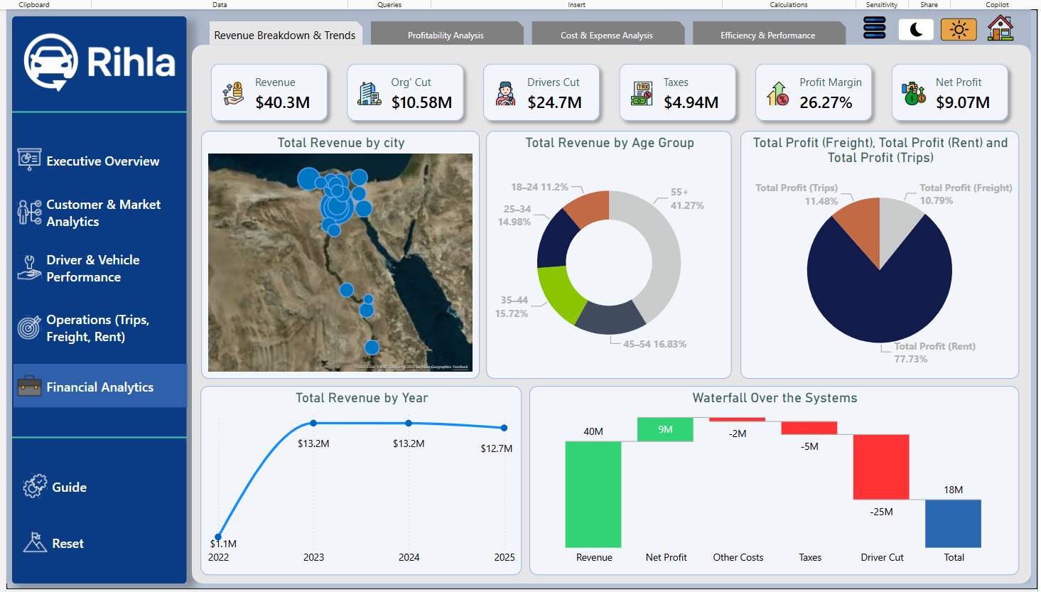
Data Visualization
Rent Dashboard
This dashboard presents a breakdown of revenue and profit for a business, showing a total revenue of $40.3M and a net profit of $9.07M with a profit margin of 26.27%. The revenue is primarily generated from rent, contributing to 77.73%, followed by trip profits at 11.48%. The 18-24 age group contributes the largest share of the revenue (41.27%). A recommendation would be to focus on expanding services in areas with high revenue potential and further analyze age demographics to target high-revenue groups more effectively. Additionally, reducing taxes and the driver cut could improve overall profit margins.

Slide 44
Looker
Looker provides Rihla with a modern, cloud native business intelligence platform that enables embedded analytics and self-service data exploration. Its powerful LookML modeling layer ensures consistent, governed metrics, allowing teams to build scalable dashboards and deliver trusted insights across trips, freight, rentals, and fleet maintenance.

Slide 45
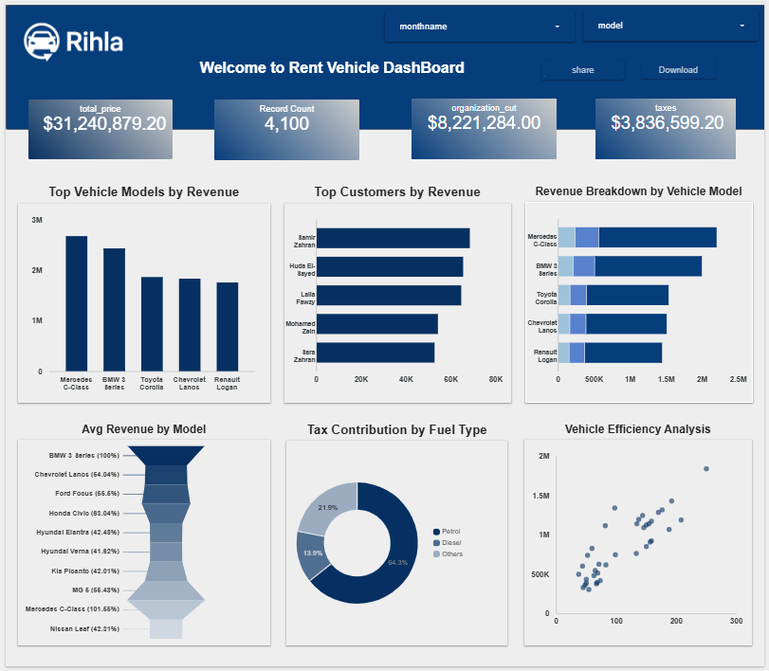
Data Visualization
Looker Dashboard
The Looker-powered Rent Vehicle Dashboard delivers comprehensive financial and operational insights, reporting total revenue of $31.24M, rental count of 4,100, organizational share of $6.22M, and profit of $3.84M. Key insights highlight BMW 5 Series leading average revenue per model, strong performance from premium models (Mercedes, Chevrolet) in top revenue generators, significant tax contributions from petrol vehicles, and clear vehicle efficiency trends correlating higher usage with increased revenue.

Slide 46

Python Analysis
Python serves as the core language for advanced data analysis in Rihla, leveraging powerful libraries such as Pandas, NumPy, Matplotlib, and Seaborn to process and explore large-scale ride, freight, and rental datasets. Through custom scripts and Jupyter Notebooks, we performed in-depth exploratory data analysis, statistical modeling, and predictive tasks to uncover actionable insights and support strategic decision-making across the platform.

Slide 47
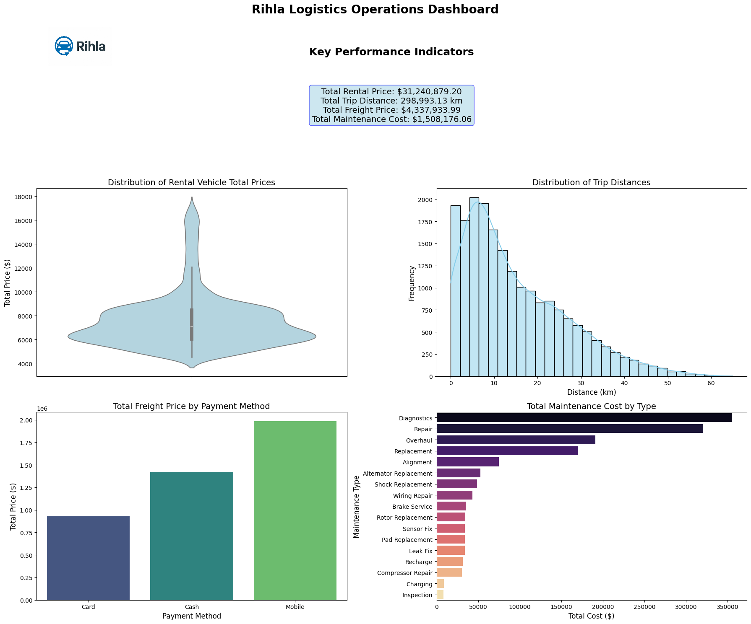

The Rihla Logistics Operations Dashboard provides a consolidated view of financial and operational performance, recording total rental price of $31.24M, trip distance cost of $9.38M, freight price of $4.34M, and maintenance cost of $3.29M. Key insights reveal rental vehicle prices concentrated around a central peak, trip distances predominantly short-range (declining sharply beyond 50 km), mobile payments dominating freight transactions, and maintenance costs led by diagnostics, overhaul, and replacement activities

Slide 48
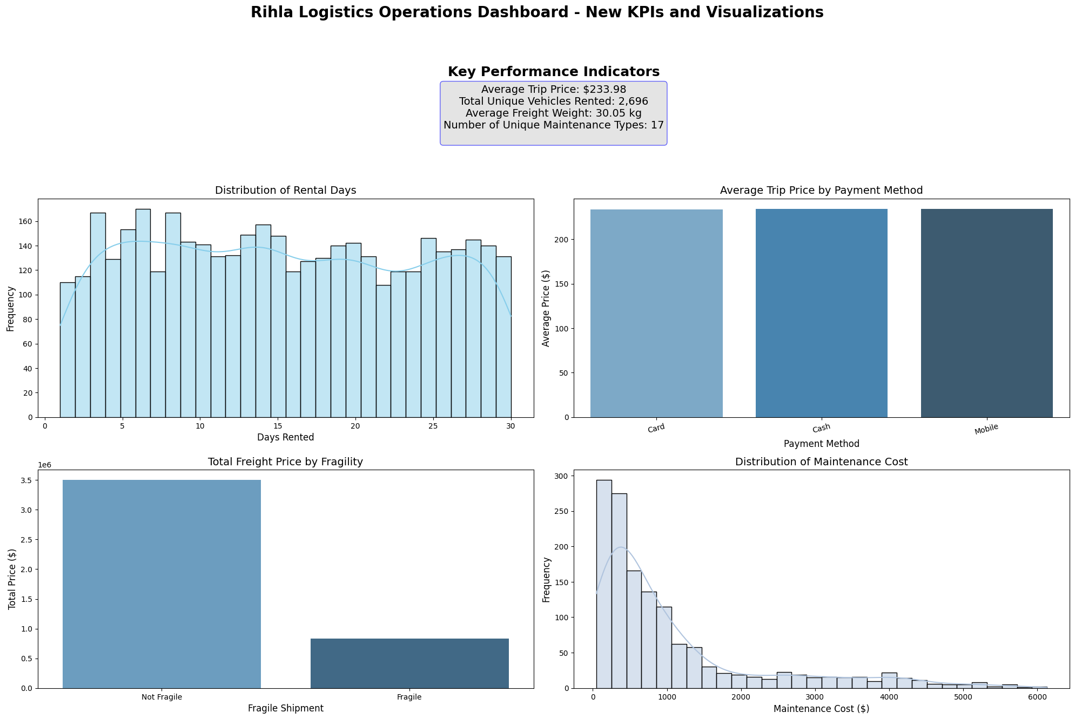
The Rihla Logistics Operations Dashboard introduces enhanced KPIs and visualizations, highlighting an average trip price of $233.58, total unique vehicles rented at 2,696, average freight weight of 20.89 kg, and 17 distinct maintenance types. Key insights show rental days most frequently between 5–15 days, significantly higher average trip prices for mobile payments compared to card and cash, fragile shipments commanding premium pricing, and maintenance costs heavily skewed toward lower-value repairs with a long tail of occasional high-cost events.

Slide 49
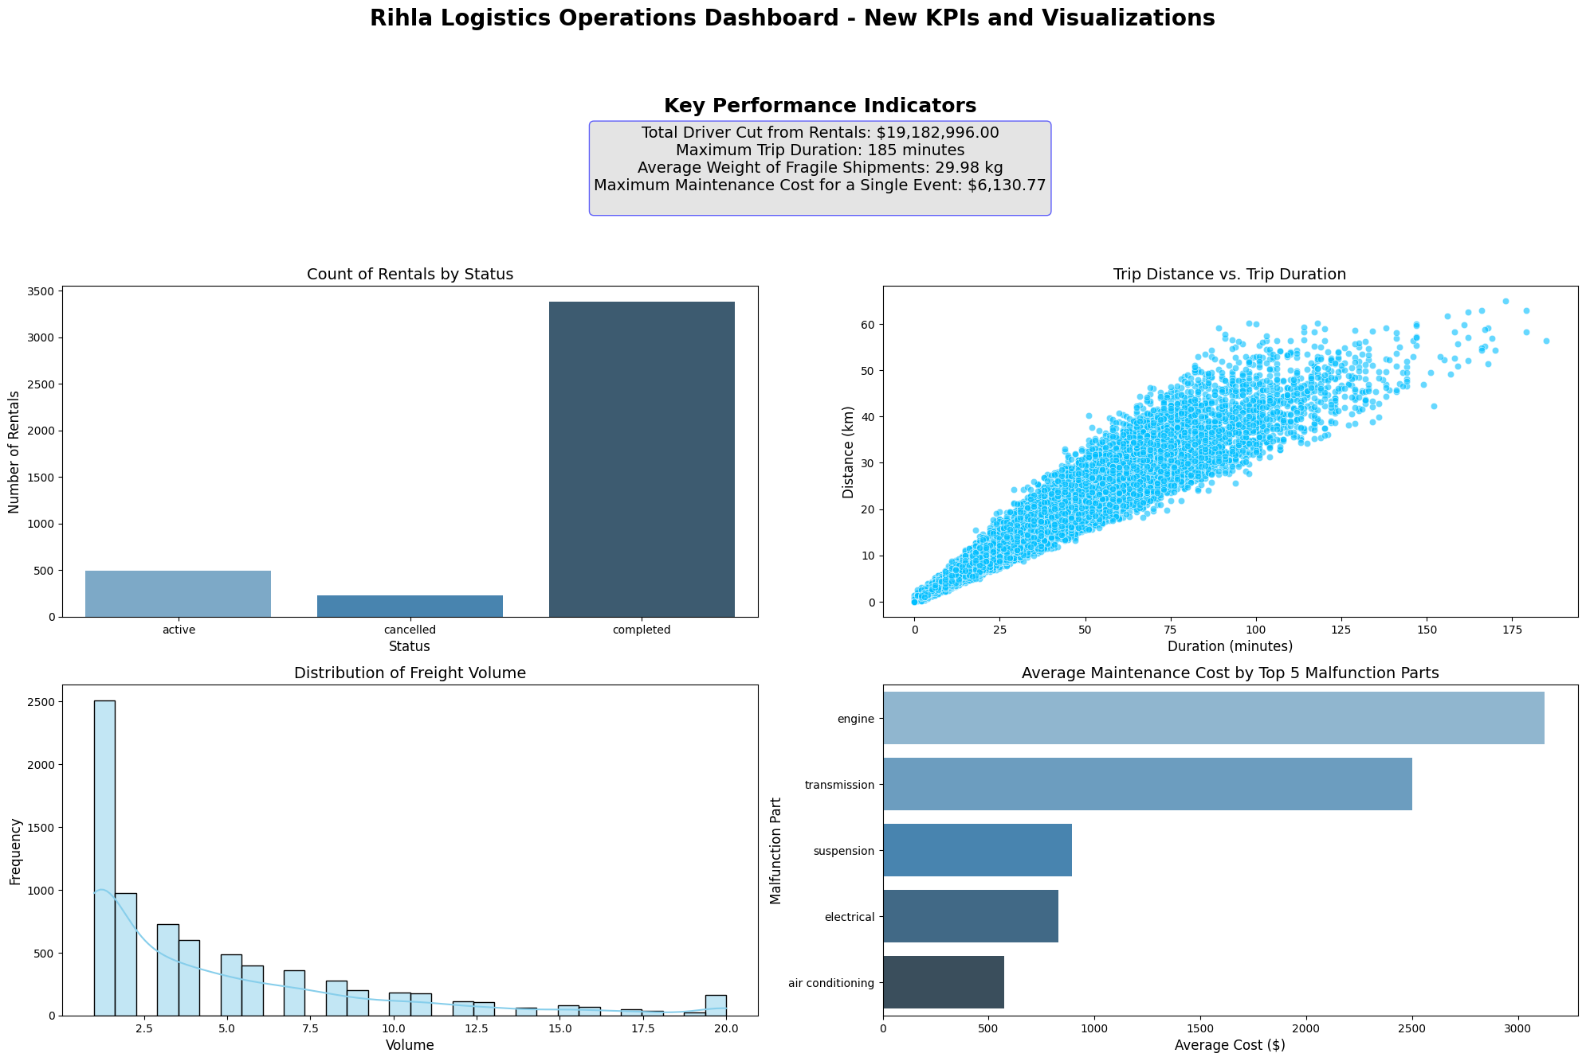
The Rihla Logistics Operations Dashboard presents advanced KPIs and visualizations, reporting total driver cut from rentals of $15.18M, average trip duration of 185 minutes, average weight of fragile shipments at 29.98 kg, and a maximum single-event maintenance cost of $61,307. Key insights reveal the vast majority of rentals in "completed" status with minimal cancellations, strong positive correlation between trip distance and duration, freight volume heavily concentrated in lower ranges, and highest average maintenance costs for engine ($2,200+), followed by transmission and suspension components.

Slide 50


Rihla Website
Discover all the features and services offered by Rihla. From booking your next ride to exploring our latest offers, everything you need is just a click away. Visit us today for a seamless travel experience.
For more details, scan the QR code or visit the link below:
https://rihla.rf.gd/

Slide 51

Web site
The Rihla web application, developed using Visual Studio Code, serves as a centralized portal for interactive dashboards. It seamlessly embeds Power BI, Tableau, Looker reports, and Python-generated visualizations, providing stakeholders with unified, real-time access to key operational and analytical insights across trips, freight, rentals, and fleet performance

Slide 52
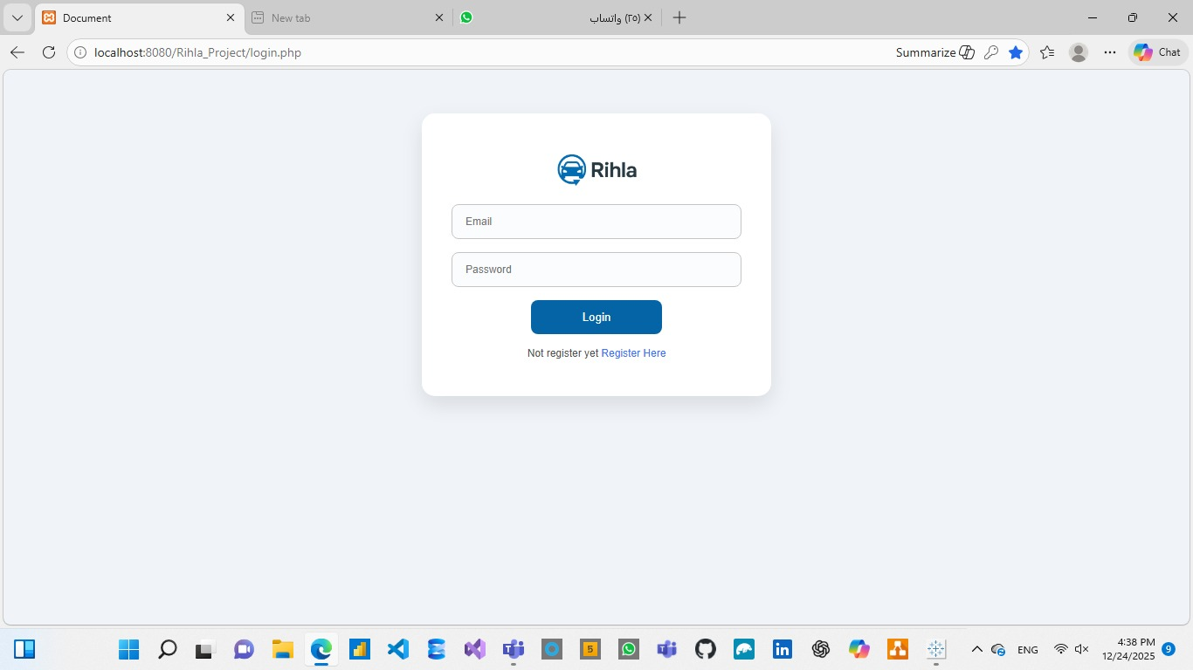
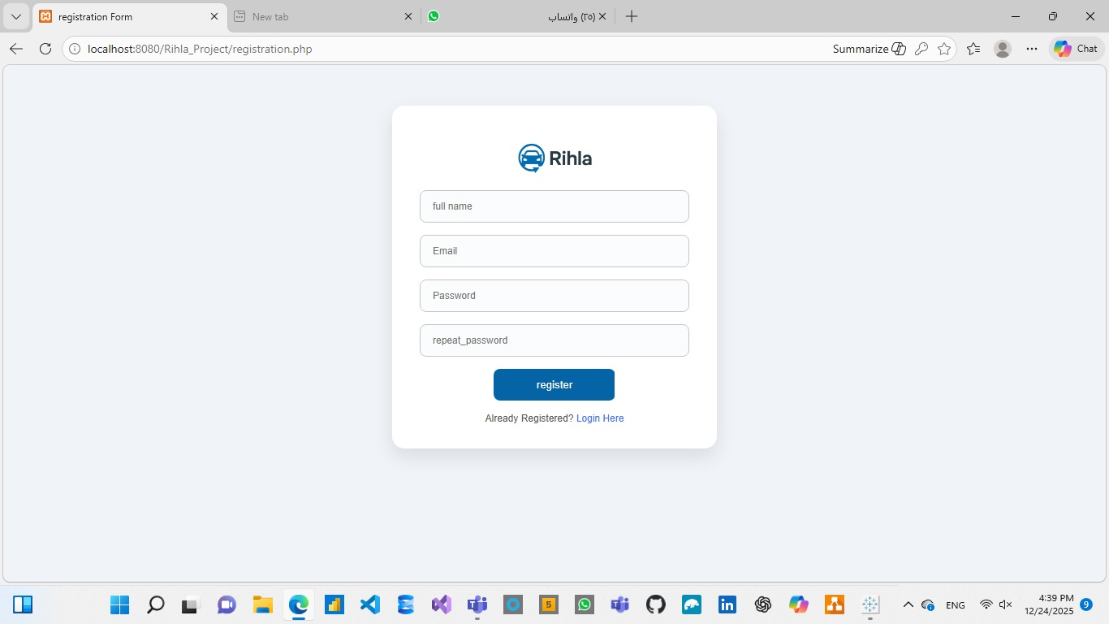
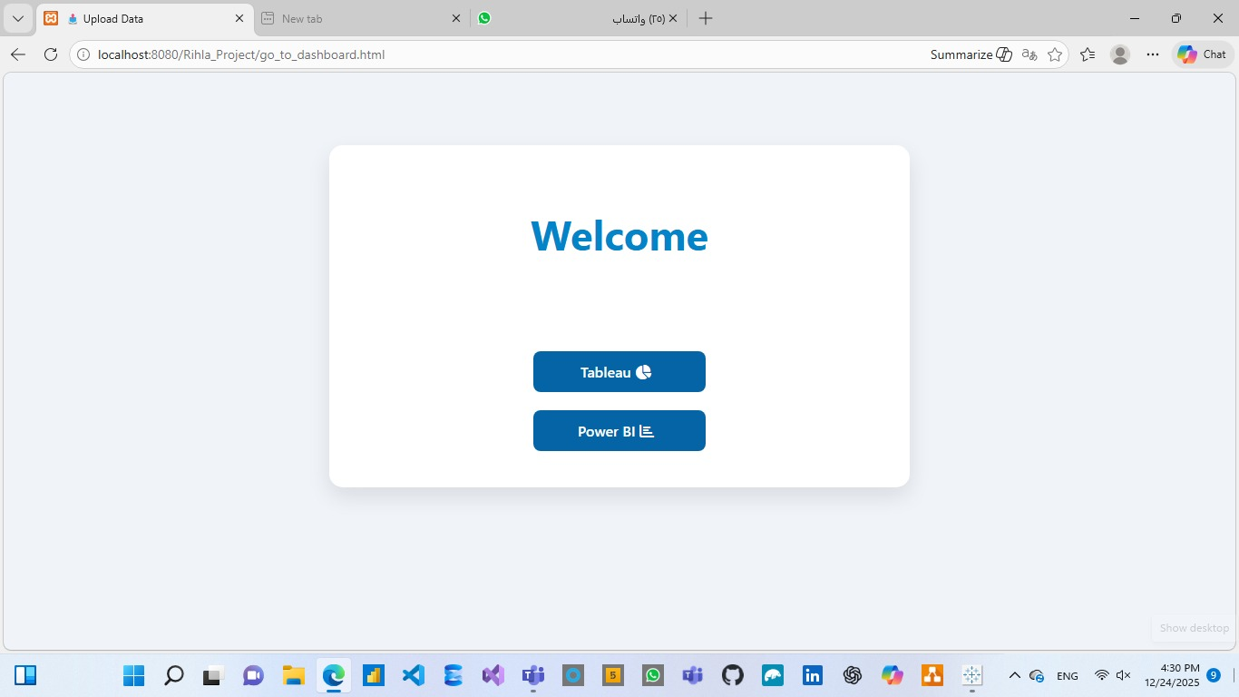
Website
Consist of 3 pages to log in system Dashboards

Slide 53
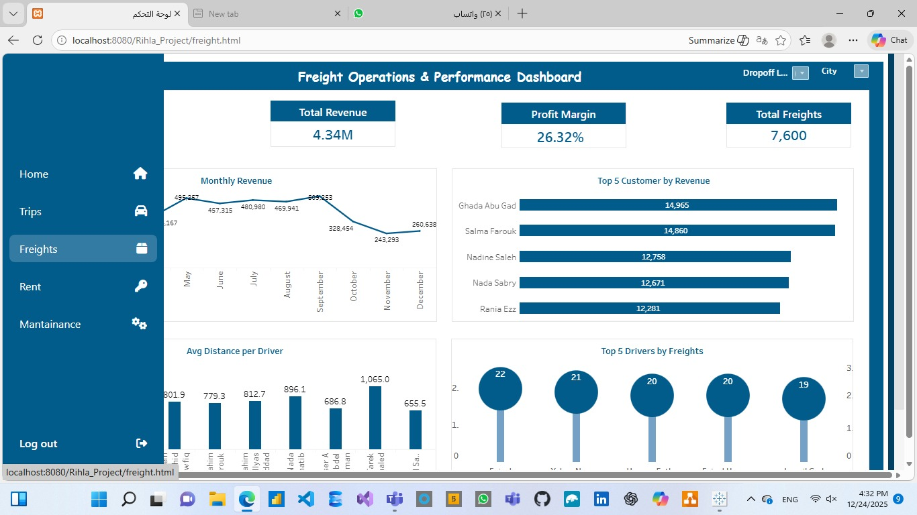
Website
Consist of 3 pages to log in system Dashboards

Slide 54
Visualization Tools

Slide 55




Software tools

Slide 56
THANK YOU!

